Slide 1
Equal North: why a research network for health inequalities?
Paul Johnstone – Regional Director (North)
Newcastle FUSE 12th January 2017

Slide 2
1. The ‘north-south divide’?
2. Health inequalities since 2014
3. Reflections for going forward
Notes:
Explain first what happened after DN published
Acknowledge Dame Margaret’s work

Slide 3
Activities since Due North was published
Annual ‘Due North’ conference (Blackpool, Chester, Hull), plus other conferences in Durham and Manchester
2017 conference will be in Darlington
Library of case studies
Used in DPH reports, discussed many councils, supported PH agenda in local government, some councils used for economic and children’s services planning
The commission cited as one of 12 major PHE achievements in 2014
Used to support devolution policy, community assets policy, Health Equity Board in PHE and DH

Slide 4
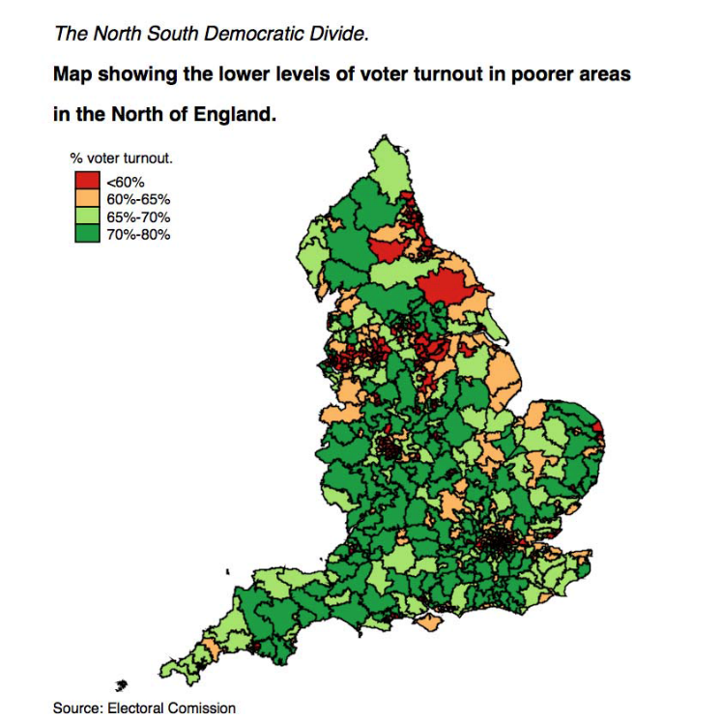
North-South life expectancy divide
North-South democratic divide
Notes:
North – South Divide
health,
democratic,
Institutionalised in one of the most centralised countries in the OECD
Impact wide ranging- here’s one- migration

Slide 5
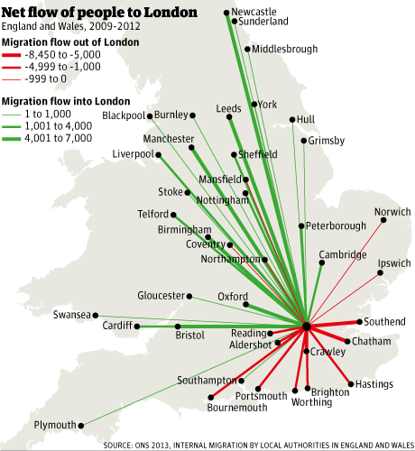
National infrastructure expenditure on transport
Internal migration net flows to London

Slide 6
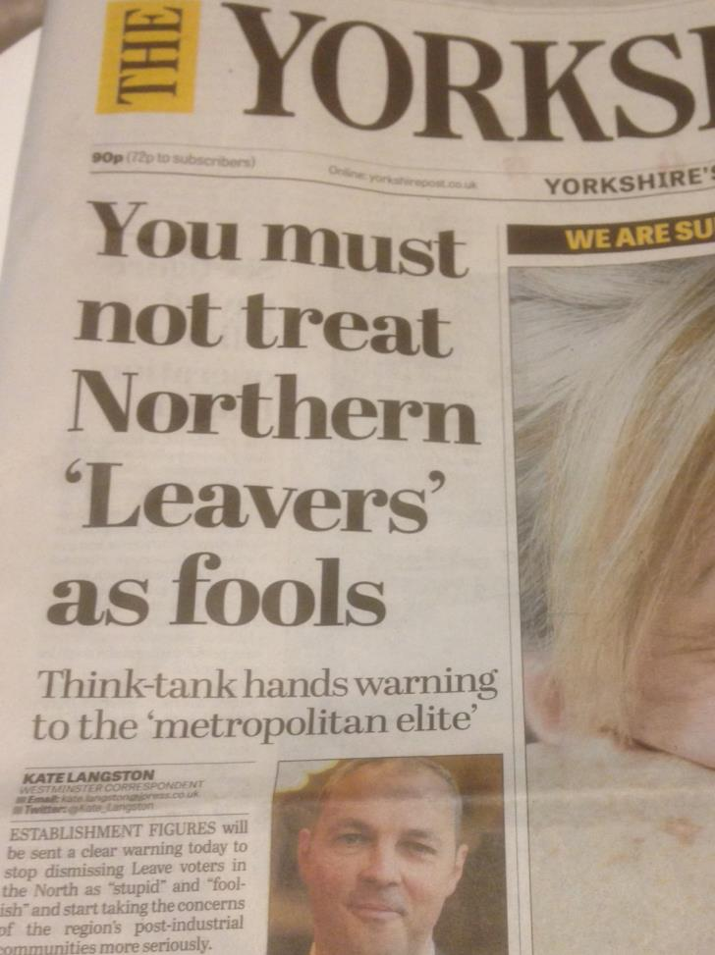
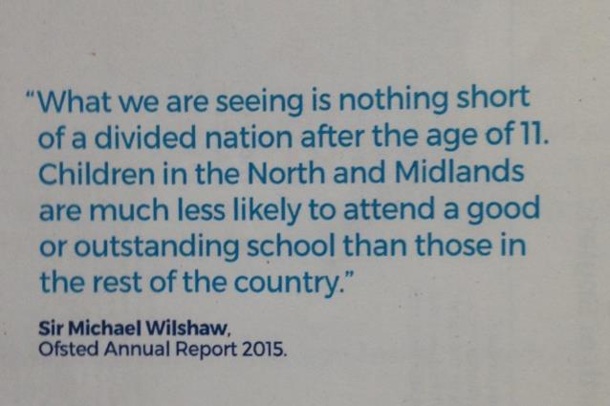
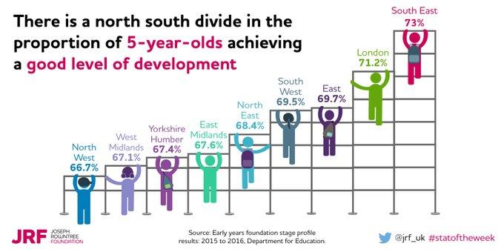
Notes:
There are many other divides; gender, ethnicity, age, disability So in some ways ‘north- south not helpful
But geographic divides holds weight.
Is an emotive expression and gets media and public – used by many, gets attention- for action, eg Northern Powerhouse,
But many examples… here are some recent one..
Ofsted
school readiness JRF social media
Growing Up North- invite interest to respond to the Children’s commissioner…Year long investigation into the real causes of education outcomes disparity between the north and south
It’s a vehicle for raising the issue of inequalities nationally
Locally focusing on geography provides an opportunity for action locally and nationally eg the Northern Powerhouse,
The geographic divide is uncomfortable for any government- a nation divided.
And this spurs action eg the Brexit vote brought that clearly into focus … some local people feel disenfranchised, traditional democratic politics has failed.
Inequality laid bare in this way shows a very clear message.
We are very centralised.

Slide 7
Notes:
The Brexit vote emphasised the divide
Wholly recognised by Government
Greg Clark
Theresa May

Slide 8
‘When transferring power from the EU to Britain, I think it is essential that Whitehall is not the default destination for them. Among the answers to the challenge that the referendum result poses has to be a much bigger role for the local in our national life’
Greg Clark MP, Secretary of State for Local Government – 2016

Slide 9
‘…That means fighting against the burning injustice that, if you’re born poor, you will die on average 9 years earlier than others.’
Theresa May, Prime Minister
13 July 2016
Notes:
This quote leads me to look at the data
The 9 year gap was quoted from a PHE analysis. LE at birth. Death always seems a strange way to describe life

Slide 10
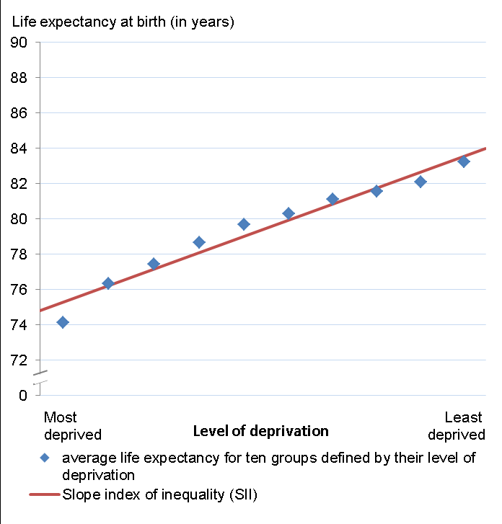
Wide inequalities in life expectancy exist between the most and least deprived areas of England, A difference of 9.2 years for men and 7.0 years for women
Males, England, 2012-14
Females, England, 2012-14
Source: PHE analysis of ONS data
Notes:
Whole population of males and females, split into deciles according to level of deprivation
Has this changed over time- at a population level- no

Slide 11
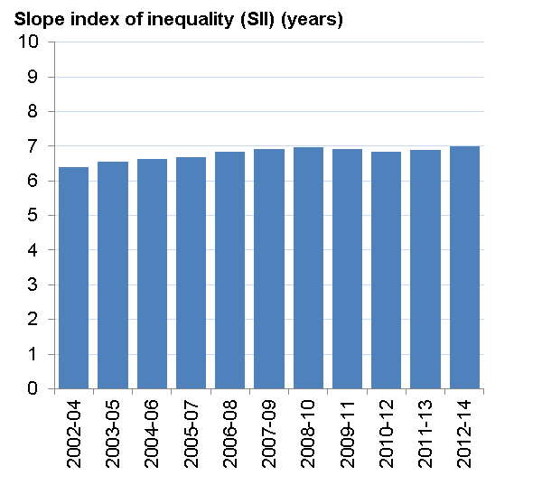
There has been little change in inequality in life expectancy over time, although for males, inequality has narrowed slightly and for females inequality has widened slightly, these changes are not statistically significant
Males, England, 2002-04 to 2012-14
Females, England, 2002-04 to 2012-14
Source: PHE analysis of ONS data

Slide 12
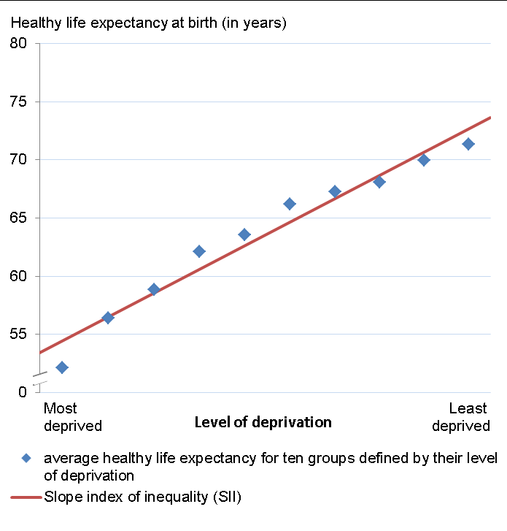
Inequalities in healthy life expectancy between the most and least deprived areas are wider than inequalities in life expectancy, with a difference of around 20 years for both men and women
Males, England, 2012-14
Females, England, 2012-14
Source: PHE analysis of ONS data
Notes:
This is what cost – socially and in money on health and social care. When JRF says inequalities costs £75bn a year
But this is at whole population level- and locally meaningless and difficult to action
So let look at more local geography… first the north and sticking with LE

Slide 13
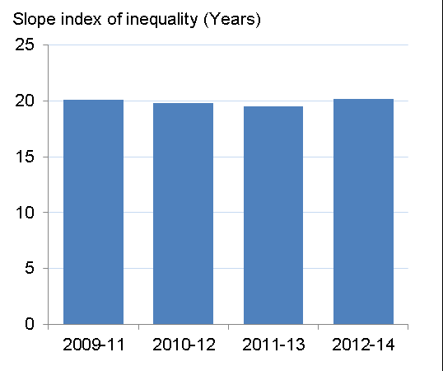
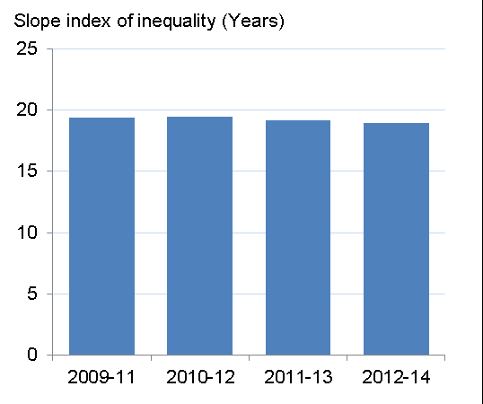
There has been no significant change in inequalities in healthy life expectancy over time for men or women
Males, England, 2009-11 to 2012-14
Females, England, 2009-11 to 2012-14
Source: PHE analysis of ONS data
Notes:
Healthy life expectancy

Slide 14
Life expectancy trends in the North
Notes:
That’s national aggregated data – what about the north and with time…

Slide 15
Life expectancy trends in the North
Notes:
Gap remains stubborn – but still looking at large geography

Slide 16
Life expectancy trends in the North
Notes:
Drill down a bit more- sub regions.
Males
Interesting patterns arise. But do we have evidence for these trends?

Slide 17
Life expectancy trends in the North
Notes:
Females in the north
But still not enough- what I am interested in is the experience of local areas- where they were before and what is happening – as a place
Spearheads- explain and Programme for Action and HINST

Slide 18
Life expectancy trends in the North
Notes:
Introduce Spearheads
Health warning about these data
Use of spearheads- introduce HI target/ Programme for Action. 10% reduction by 2010. Controversial- limited to set number
70 areas
This first slide summarises all 7- LE, all cause M and F

Slide 19
Life expectancy trends in the North
Notes:
But still need to look at the experience of individual areas, where they started, the gap with England ave AND each other, and how they progressed
YH Spearheads

Slide 20
Life expectancy at birth males since 2011 (3 year rolling averages 2010-2012 to 2013-2015). England and Y&H LAs
++ = increased above England average
+ = increased below England average
- = decreased
S= old spearhead areas
ONS data 2010-2015
Notes:
England ave
For YH – and all other spearheads outside London… the pattern is the same
Split into four groups of experience
1. Those above England Ave 4 years ago- increased above the average still further
Those below England Ave 4 years ago – 3 further groups
3 increased rates above the England Ave rate (0.4 years in the time period) so closed the gap (Leeds Calderdale and Kirklees)
7 increased but below the England average- hence gap increased
1 (Hull) decreased LE completely
All 7 spearheads remained at the bottom and increased the gap to England average
The gap between the top and bottom increased (3.5 years to 4.0 year gap)

Slide 21
Life expectancy at birth females since 2011 (3 year rolling averages 2010-2012 to 2013-2015). England and Y&H LAs
Notes:
Same three at the top and increased gap
Those starting below the England average…
3 (Kirklees, NEL, Wakefield ) increased above the rate of England Ave (0.2) hence closed the gap
4 (Sheffield Leeds, Barnsley, Doncaster) increased but less than England Ave increase so gap widened
5 (NL, Calderdale, Rotherham, Bradford, Hull) decreased against England Ave hence so widened
Nearly all Spearheads at bottom and remained at bottom
Gap from top to bottom increased from 3.1 years to 3.9 years)

Slide 22
Changes in Life Expectancy for males at birth over 4 years of 3 year averages (mid points 2010-2012 to 2013-2015), English regions
Notes:
Consistent pattern when looked at this way

Slide 23
Changes in life expectancy for females at birth over 4 years of 3 year averages (mid points 2010-2012 to 2013-2015), English regions

Slide 24
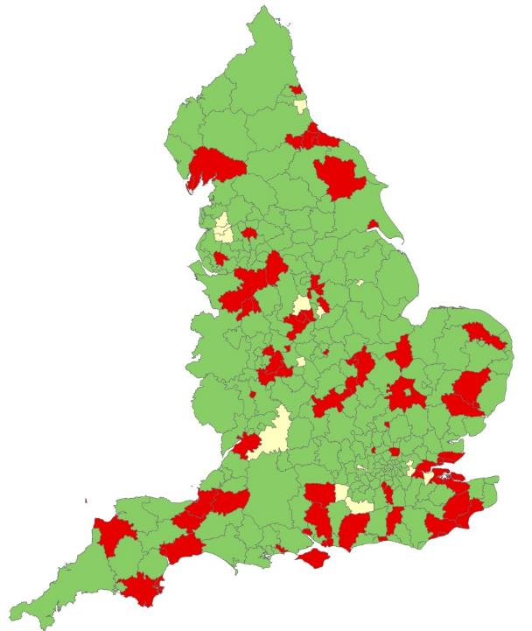
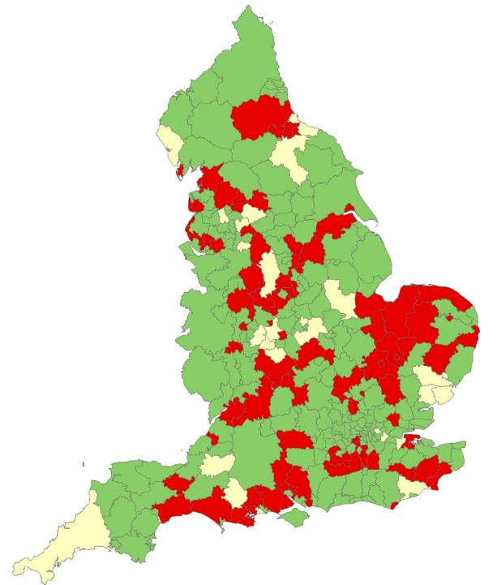
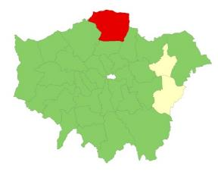
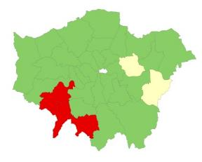
Changes in life expectancy Change in life expectancy at birth from 2010-12 to 2013-15 by Local Authority
Change in male life expectancy at birth (years)
Change in female life expectancy at birth (years)
London
London
Change from
2010-12 to 2013-15
Rise
No change
Fall
Source: Public Health England analysis of data from Office for National Statistics
24
Notes:
Changes in LE
But at a national level, no correlation between changes at LA level in last three years and deprivation

Slide 25
Life expectancy at birth change, 2010-12 to 2013-15: males (with deprivation score)

Slide 26
Health divide: what has happened since 2014?
Gap not closed
On some measures it has worsened
Comparing experience of individual places provides a story and
Spearhead analysis helps
Caveats with the data

Slide 27
What next? Context
Notes:
So what can be done
Populism and New Govt, LG funding, devo, money, Inclusive growth Commission
Wide context- increased automation (Mark Carney)
Mark Carney’s speech in Liverpool

Slide 28
Mark Carney – Governor , Bank of England, Liverpool, December 2016
‘..globalisation is associated with low wages, insecure employment, stateless corporations and sticking inequalities.’
‘Trade and technology do not raise all boats’.
‘..up to 15m of current jobs in Britain could be automated over time.’
Now may be the time of the famous and fortunate but what of the frustrated and frightened?’

Slide 29
… and Bank of England’s solutions
‘For free-trading, networked countries to prosper, they must first re-distribute some of the gains from trade and technology and then re-skill and reconnect all their citizens. By doing so they can put individuals back in control.’
‘For free trade to benefit all requires some redistribution
‘Lifelong learning, ever-greening skills and cooperative training will become more important than ever.’

Slide 30
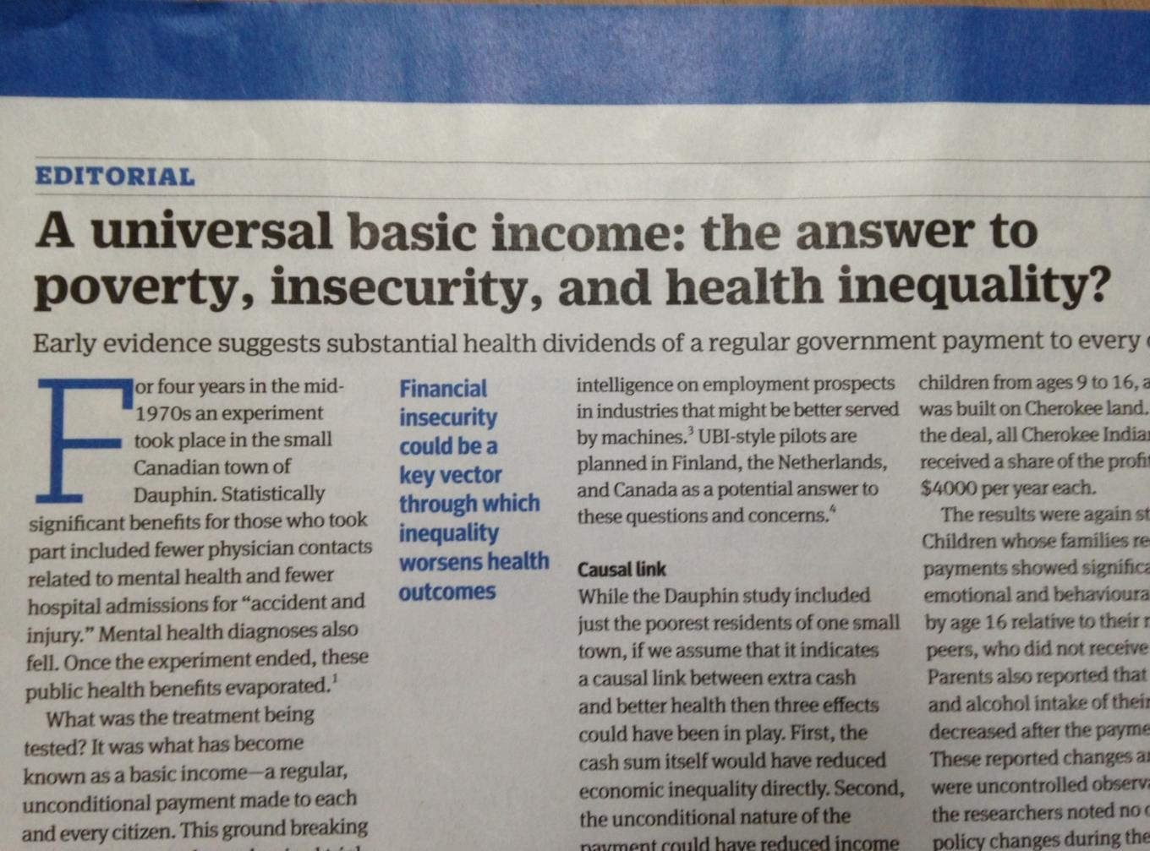

Slide 31
Notes:
Engage with the business sector
Leeds City council, combining economic and poverty reduction strategy

Slide 32
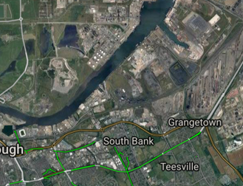
Notes:
One example where geographic health divides made a difference and enabled research into practice was the policy of ‘spearhead areas’. 2004, introducing for the first time an inequality national target. Enabled action local and national. HINST, Enabled local busy managers and local politician to focus on the action needed not just stare at graphs and colour maps.
Also I can use the Teesside – South Bank question. Whatever decision the then health authority made – what was the impact? (Mark Reilly credit.) Insert map.
One of the problems with today’s policy on inequalities, where the NHS and local authorities have a statutory requirement under the Health and Social Care Act (2012) to reduce inequalities is that it’s difficult to quantify and act on. Like this, tackling inequalities is difficult to measure and provide accountability for action. I would like to see a return of spearheads approach and the learning which helped this. Devolution deals go some way to help but needs more to recognise that some places, defined geographically, require special and extra national help to catch up.

Slide 33
Research needed
Policy advice for local areas and national (The statutory requirement to reduce inequalities in HSC Act 2012 is not enough)
Spearhead/ NST model learning
‘South- Bank Question’ and local HiAPs
STPs/ NHS
Devolution opportunities and national ‘structural change’
The new economic agenda /inclusive growth- what makes a difference, asset approaches
Learning from the network and national HiAP

Slide 34
Launch of Due North blog site

